Slide 1
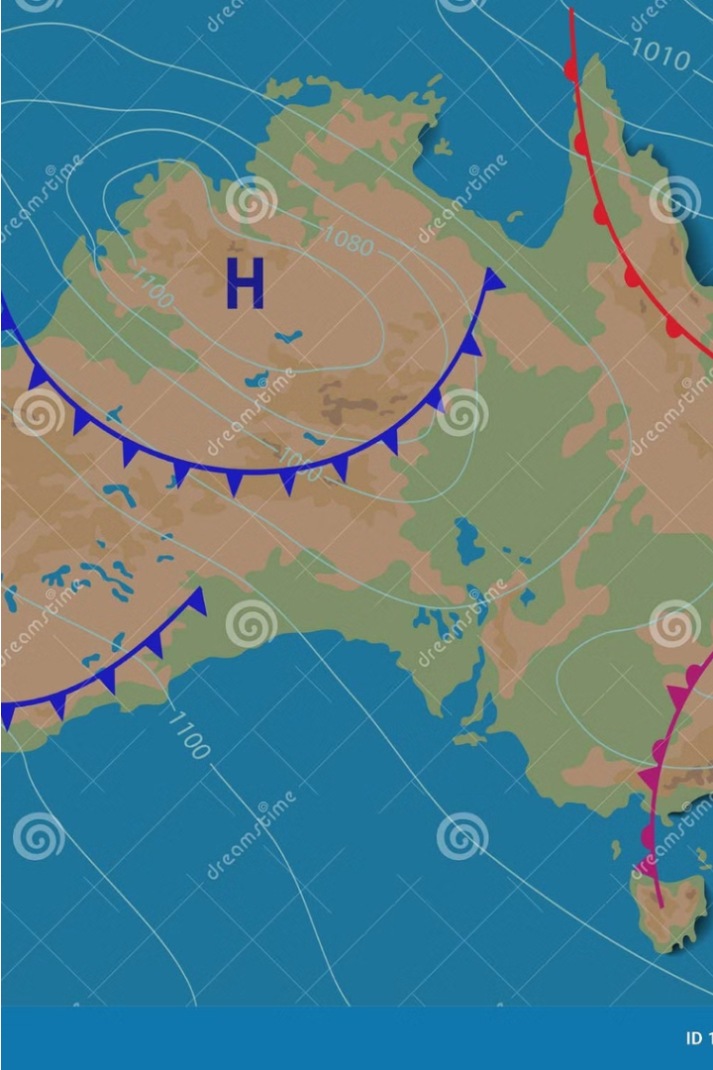
Australia's temperature analysis:
Presented By:
Hassan Ehab
Mohamed Khaled
Mohamed Walid

Slide 2
Outline
Data description & objective
Data exploration and Visualization
Trend Surface Model (TSM)
Inverse Distance Weighting (IDW)
Kriging
Conclusion & Recommendations

Slide 3
Data description & Objective
The Australian Temperature dataset, sourced from Kaggle, includes data from 112 weather stations across Australia from 1975 to 2019.
The dataset contains 5037 observations, all of which are complete and relevant to 1980, with a specific focus on 112 observations for that year.
The study aims to improve Australia's understanding of temperature variations by highlighting significant spatial patterns and providing recommendations for policymakers, researchers, and stakeholders.

Slide 4
Data Exploration and Visualization
Exploring spatial autocorrelation in Australia's temperature in 1980 using global Moran's I and localized version, comparing observed with expected results, and determining if Gaussian distribution follows.
Test | Variable | Statistic | P-value | Normality
 | Latitude | 1.2002 | 0.0038 | No
Anderson-Darling | Longitude | 5.3136 | <0.001 | No
Anderson-Darling | Temperature | 0.3565 | 0.4511 | Yes
Anderson-Darling
The global Moran's I is significant at α = 0.05, indicating positive spatial autocorrelation and potential clustering in the dataset due to similar temperatures at the nearest locations.
Observed | Expected | Standard deviation | P-value
0.3662942 | -0.009009009 | 0.02569523 | 0

Slide 5
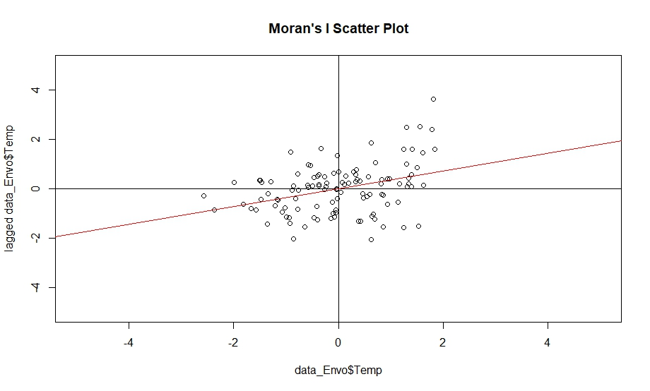
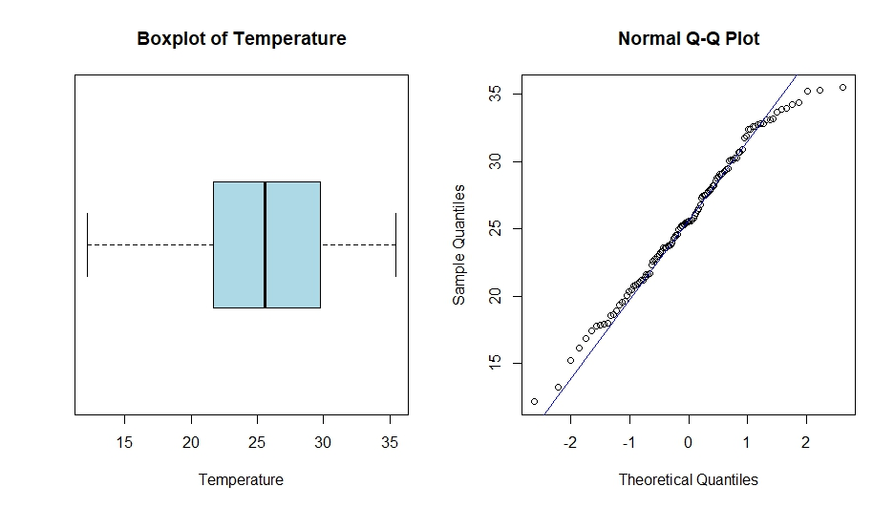
Data Exploration and Visualization
Moran's I Plot
Boxplot and Q-Q plot
• Positive spatial autocorrelation observed with a positive slope.
• Possible clusters in High-High and Low-Low areas.
• Possible spatial outliers in Low-High or High-Low areas.
• No outliers found in temperature boxplot.
• Distribution is symmetric and bell-shaped.
• Boxplot supports normality test.
• There are little deviations from the 45 degree line.

Slide 6
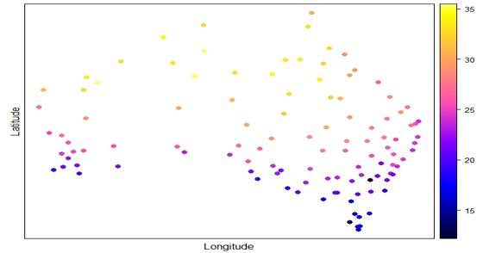
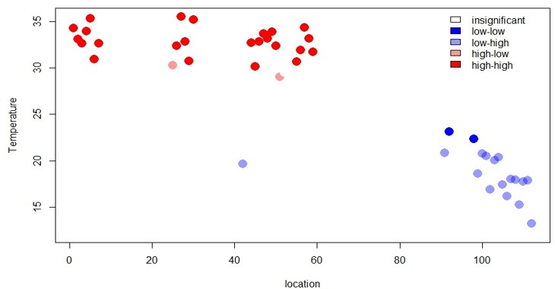
Data Exploration and Visualization
Temperature Distribution plot
Lisa plot
Temperature Distribution in North and South
• North experiences highest temperatures, South experiences lowest.
• East experiences moderate temperatures, West experiences highest.
• Cluster of high temperatures in North, possibly in Southeast.
• Possible outlier: black point with lowest temperature around blue and purple points with moderate temperatures.
• Two clusters identified: High-High (hot spot) with highest temperatures, and Low-Low (cold spot) with lowest temperatures.
• Possible spatial outlier: Light-blue point around insignificant points.

Slide 7
Trend Surface Model (TSM)
- The model aims to predict response variables using the coordinates of a location, specifically longitude and latitude.
- We will consider possible p values of 1, 2, 3, and 4 to determine the best model using metrics like Akaike Information Criteria AIC and Adjusted R-squared.
Model Selection for Australian Temperature Pattern Analysis:
• 3rd order chosen due to high adj.R2 and low AIC.
• 4th order also has high adj.R2 and lowest AIC, but difference isn't significant.
• Decision based on number of parameters to be estimated, affecting prediction precision.
• 3rd order chosen due to lower number of parameters.

Slide 8
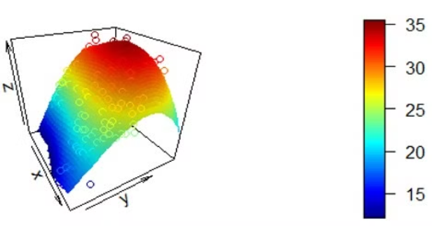
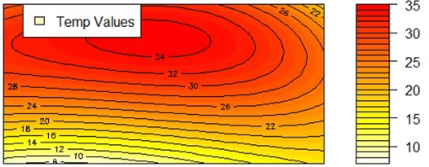
Trend Surface Model (TSM)
3D plot (p = 3)
Contour plot
The figure displays a 3-dimensional plot illustrating the cubic relationship between longitude, latitude, and temperature, along with a contour plot for easier interpretation.
The study reveals that the highest temperature is at longitude 130 and latitude -20, while the coolest is at longitude 120 and latitude -40.

Slide 9
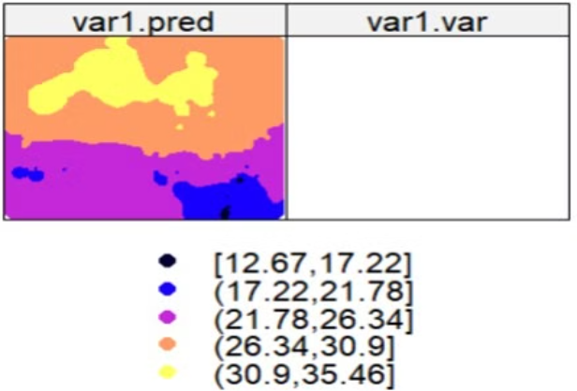
Inverse Distance Weighting (IDW)
• The variance plot for interpolated points is empty due to IDW being a mathematical relation without random component, unlike kriging models.
Prediction for 30000 Points shows:
• Southeast part (black and blue) shows low temperatures (12.67-21.78).
• Northern part experiences increased temperatures (26.34-35.46).
• Center of study area shows moderate temperatures (21.78-26.34).

Slide 10
Kriging
• Compute distances and weights for variogram investigation.
• Choose optimal variogram parametric model for dataset.
• Plot variogram cloud for variogram cloud investigation.
The boxplot indicates no outliers, but LISA plot indicates to some outliers, so we will use both Matheron and Cressie-Hawkins to show the difference and detect which fits the data well and estimating the variogram.
The variogram plot aligns with both Gaussian and linear parametric models. To avoid confusion, we will use the error sum of squares attribute and select the best fitting model.

Slide 11
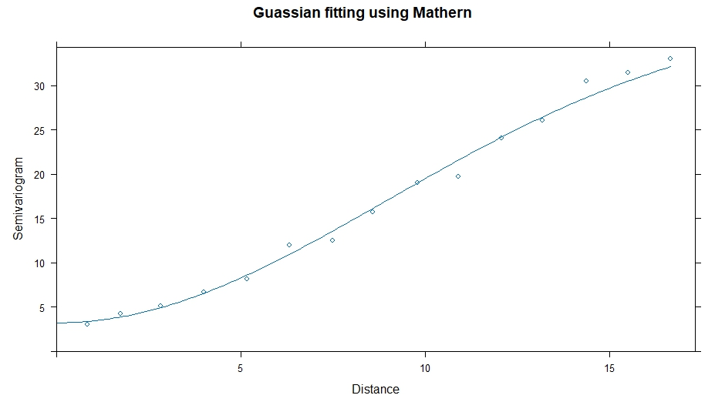
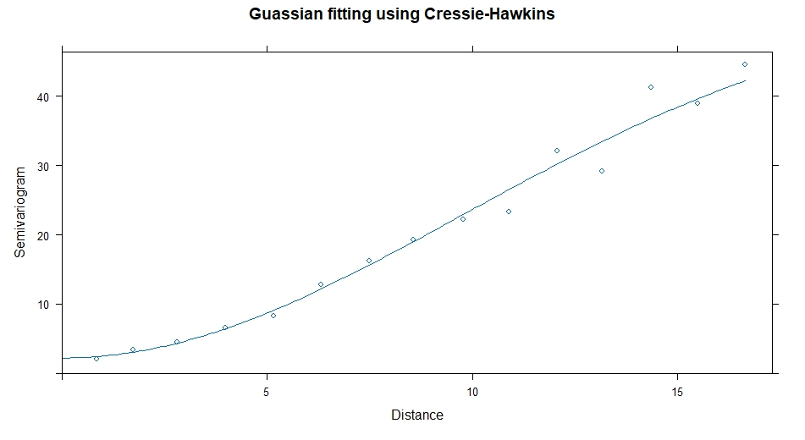
Matheron vs Cressie-Hawkins estimation for Variogram
Gaussian fitting using Matheron
Gaussian fitting using Cressie-Hawkins
SSE of Gaussian using Matheron | SSE of Gaussian using Cressie-Hawkins
39.6 | 116.16
The error sum of square is less in Matheron in spite of Cressie.
So, we complete with Matheron using the Gaussian model.

Slide 12
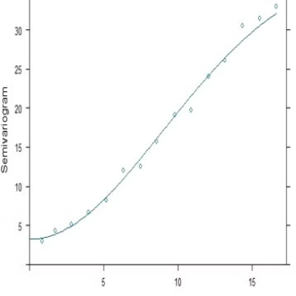
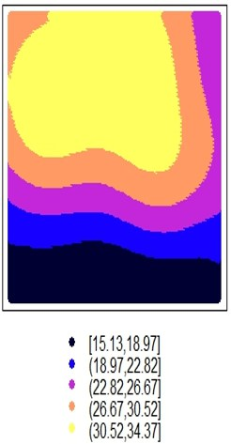
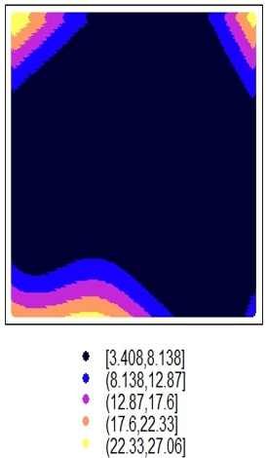
Kriging
Gaussian Fitting
Prediction map
Standard error map
The Gaussian and linear models are the most accurate parametric models for the variogram, with the Gaussian model being more accurate than the linear model.
• Temperatures generally rise in North despite South.
• Identified 5 clusters, with Yellow cluster being the hotspot with highest temperatures.
• Dark blue or black cluster is the cold spot with lowest temperatures.
• Edges require more stations due to large standard errors.
• Center has low standard error.

Slide 13
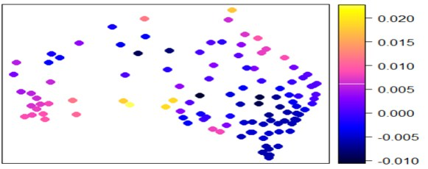
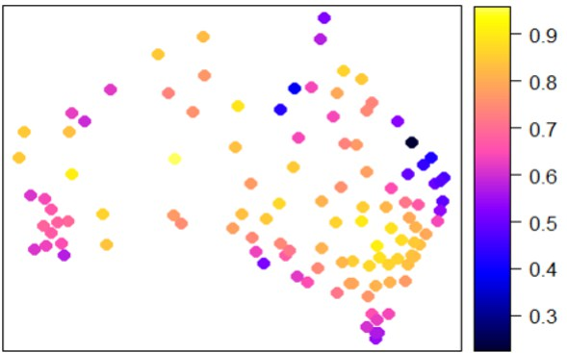
Geographical Weighted Regression Model (GWRM)
Bandwidth & Kernel
Local Variation
In most regions, the effect of elevation is negative and weak, except for the border areas in the northeast and southwest, the effect is positive
Fixed bandwidth of 2.19 with Gaussian kernel function
Local slope :elevation
Global Model
Local Slope
The global model's value is influenced by both positive and negative values, and on average, it doesn't accurately represent all data.
The study indicates that , in general, the value of R square is high in most areas, except for some border areas in the northeast.
Local R-Squared
Acceptable prediction across regions, best in southeast

Slide 14
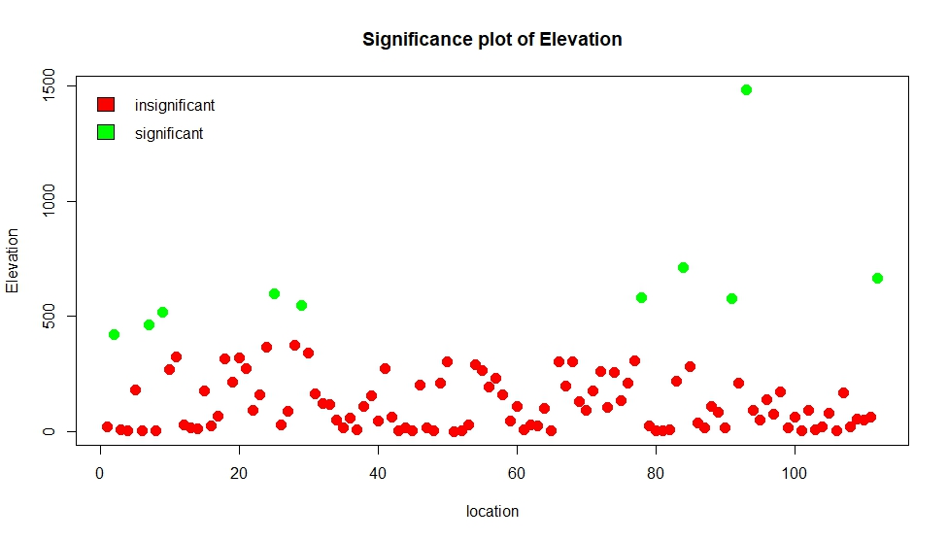
Significance of the elevation in each location
we can see that only ten locations have significant elevation in spite of the other locations and also, the more elevation increases, the more the points tend to be significant.

Slide 15
Conclusion & Recommendations
Hot North
Inaccurate Boundary
More Stations
The study uses IDW and kriging to predict temperature in the northern part of the area, with high values in the middle and cool weather in the southern part.
The study's temperature prediction for the outskirts is inaccurate, with errors increasing as the area's boundaries are approached, unlike the middle part with the lowest error.
The study shows low R-squared in the eastern part, suggesting the need for more border stations for better temperature prediction accuracy, and no need for middle stations.

Slide 16

Thank you from:
Mohamed Walid
Mohamed Khaled
Hassan Ehab
To Dr Sara 🥰

